Slide 1
CS35L Software Construction Laboratory Week 6; Lecture 1

Slide 2
Parallelism & Multithreading

Slide 3
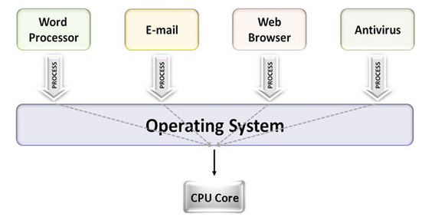
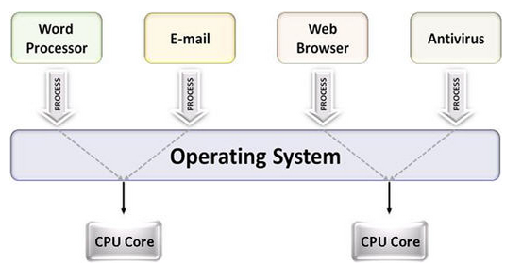
Multiprocessing
The use of multiple CPUs/cores to run multiple tasks simultaneously
Uniprocessing system
Multiprocessing system

Slide 4
Multi Processing on a single core
Process3
Process2
Process
Process2
Process2
Process1
Process1
Time
Courtesy: Nandan Parikh

Slide 5
Multi Processing on 2 cores
Process running on core 1
Process running on core 2
Process4
Process4
Process
Process3
Process3
Process2
Process2
Process1
Process1
Time
Courtesy: Nandan Parikh

Slide 6
Parallelism
Executing several computations simultaneously to gain performance
Different forms of parallelism
Multitasking
Several processes are scheduled alternately or possibly simultaneously on a multiprocessing system
Multithreading
Same job is broken logically into pieces (threads) which may be executed simultaneously on a multiprocessing system

Slide 7
Usecase : Word Processor
Consider a word processor. It has the below features:
Typing in from keyboard
Displaying to stdout
Spellchecker
Auto-save to disk
Connect to internet to view different templates
How to run all of this on a 2-core machine? Separate processes?
Enter Threads!

Slide 8
What is a thread?
A flow of instructions, path of execution within a process
The smallest unit of processing scheduled by OS
A process consists of at least one thread
Multiple threads can be run on:
A uniprocessor (time-sharing)
Processor switches between different threads
Parallelism is an illusion
A multiprocessor
Multiple processors or cores run the threads at the same time
True parallelism

Slide 9
Process vs Threads
Different processes see separate address spaces
good for protection, bad for sharing
All threads in the same process share the same memory (except stack)
good for sharing, bad for protection
each thread can access the data of other thread

Slide 10
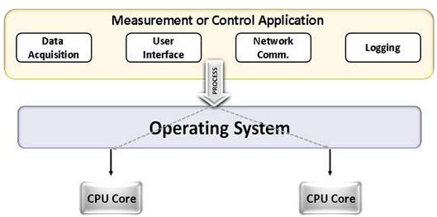
Multitasking vs. Multithreading
Multitasking
Multitasking
Multithreading

Slide 11
Multi Threading on 2 cores
Thread running on core 1
Thread running on core 2
Thread2Process2
Thread2Process2
Thread
Thread1Process2
Thread1Process2
Thread2Process1
Thread2Process1
Thread1 Process1
Thread1 Process1
Time
Courtesy: Nandan Parikh

Slide 12
Multithreading & Multitasking: Comparison
Multithreading
Threads share the same address space
Light-weight creation/destruction
Easy inter-thread communication
An error in one thread can bring down all threads in process
Multitasking
Processes are insulated from each other
Expensive creation/destruction
Expensive IPC
An error in one process cannot bring down another process

Slide 13
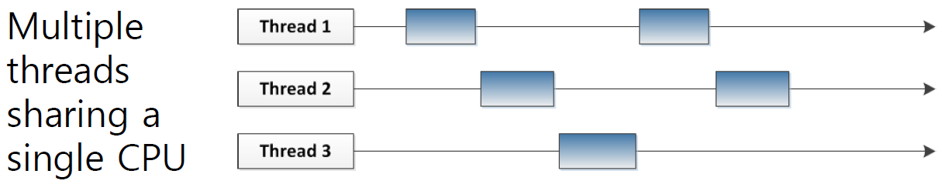
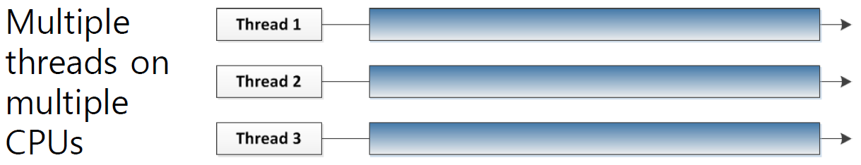

Slide 14
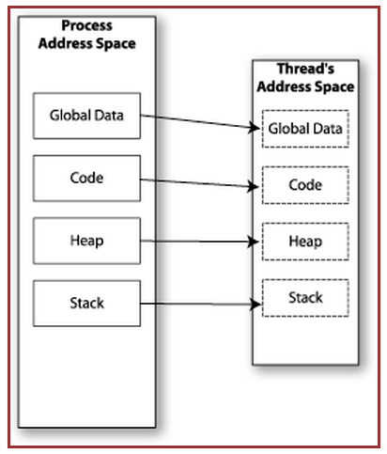

Memory Layout: Single-Threaded Program

Slide 15
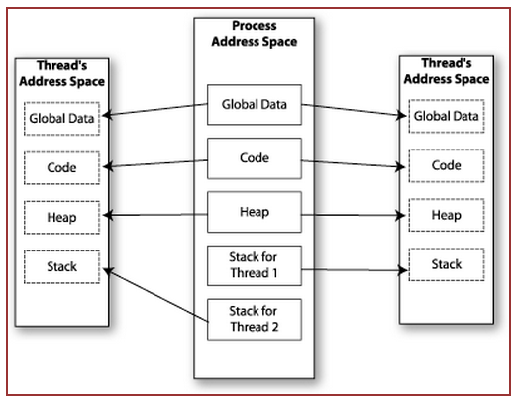

Memory Layout: Multithreaded Program

Slide 16
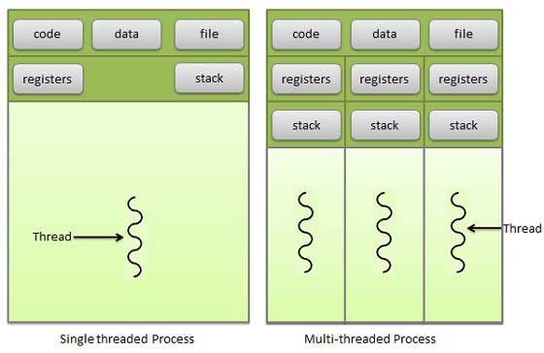
Multithreading memory layout

Slide 17
Shared Memory
Makes multithreaded programming
Powerful
can easily access data and share it among threads
More efficient
No need for system calls when sharing data
Thread creation and destruction less expensive than process creation and destruction
Non-trivial
Have to prevent several threads from accessing and changing the same shared data at the same time (synchronization)

Slide 18
Process/thread synchronization
Why is it needed?
Because threads share the same resources, we need synchronization
To prevent inconsistency

Slide 19
Race Condition
int count = 0; void increment()
{ count = count + 1; }
A
B
C
r(count) : 0
w(count) : 1
time
r(count) : 1
r(count) : 1
w(count) : 2
w(count) : 2
Result depends on order of execution
=> Synchronization needed

Slide 20
Example
a=10
P(){
read(a);
a = a+1;
write(a);
}
#1: P1 should first execute P and then P2.
Ans = 12
#2: P1 -> reads a=10, context switch to P2
P2 -> reads a=10, adds 1 to a -> 11, switch to P1
P1 -> (has already read 10) a=11
Ans = 11

Slide 21
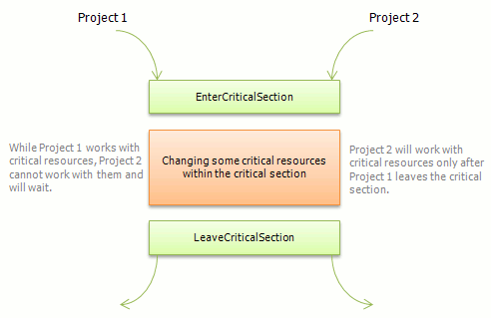
How to deal with it?
Critical section (prevents race condition)

Slide 22
Mutex
Mutex is an object which allows only one thread into a critical section
Mutex is owned by a thread
It forces other threads which attempt to gain access to that section, to wait until the first thread has exited from the section
Each resource has a mutex

Slide 23
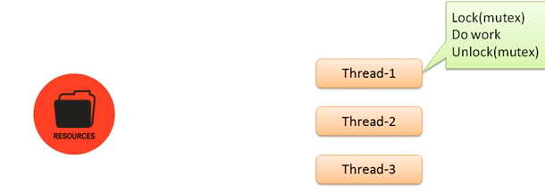

Slide 24
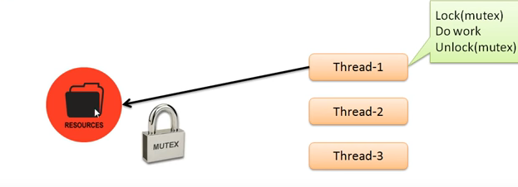

Slide 25
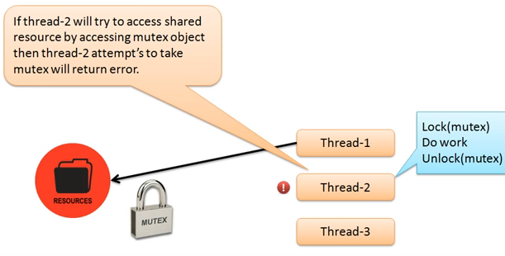

Slide 26
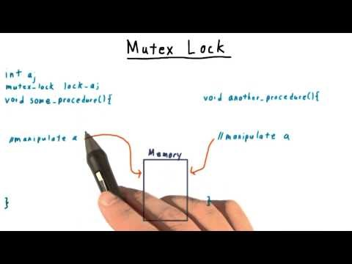

Slide 27
Semaphores
A semaphore is a value in a designated place in the OS (or kernel) storage that each process can check and then change.
signaling mechanism
restricts/allows the number of simultaneous threads of a shared resource upto a maximum number
threads can request access to a resource (decrements the semaphore)
threads signal that the have finished using the resource (increments the semaphore)

Slide 28
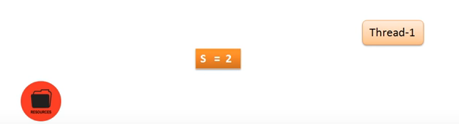

Slide 29
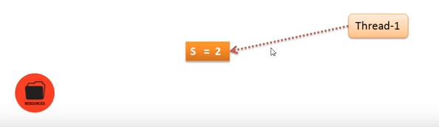

Slide 30
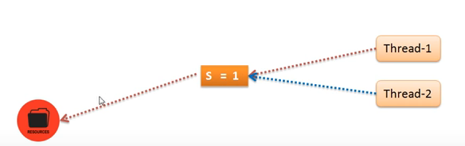

Slide 31
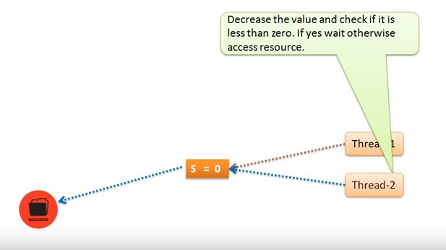

Slide 32
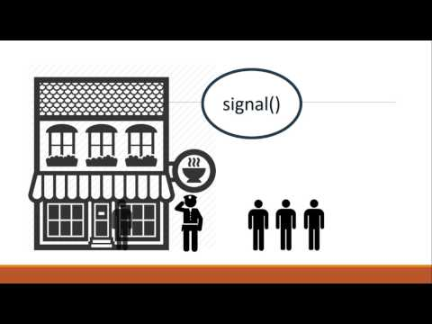

Slide 33
Semaphores v/s mutex
Semaphore allows multiple program threads to access the finite instance of resources.
On the other hand, Mutex allows multiple program threads to access a single shared resource but one at a time.

Slide 34
Multitasking
$ tr -cs 'A-Za-z' '[\n*]' | sort -u | comm -23 – words
Process 1 (tr)
Process 2 (sort)
Process 3 (comm)
Each process has its own address space
How do these processes
communicate?
Pipes/System Calls

Slide 35
Multithreading
Threads share all of the process's memory except for their stacks
=> Data sharing requires no extra work (no system calls, pipes, etc.)

Slide 36
POSIX Threads
import the pthread library
Example: #include<pthread.h>
Use -pthread while compiling
Represented by pthread_t (datatype)

Slide 37
Basic pthread Functions
There are 5 basic pthread functions:
1. pthread_create: creates a new thread within a process
2. pthread_join: waits for another thread to terminate
3. pthread_equal: compares thread ids to see if they refer to the same thread
4. pthread_self: returns the id of the calling thread
5. pthread_exit: terminates the currently running thread

